Slide 1
Dependencies Demystified
Jason Bock

Slide 2
Personal Info
http://www.jasonbock.net
https://www.twitter.com/jasonbock
https://www.github.com/jasonbock
jason.r.bock@outlook.com

Slide 3
Downloads
https://github.com/JasonBock/
DependenciesDemystified
https://github.com/JasonBock/Presentations

Slide 4
Overview
Dependencies
Containers
Remember…
https://github.com/JasonBock/
DependenciesDemystified
https://github.com/JasonBock/Presentations

Slide 5






Dependencies
Notes:
Dependencies….what are they? Why should I care? Don’t they just make everything harder? I can easily connect to my service or database in code, what’s with all this misdirection, extra layers? Is this another form of job security?
Even though it really is a simple concept, it took me a while to really get my head around dependencies. But if you start to recognize dependencies in code and handle them correctly, the benefits are tremendous.

Slide 6
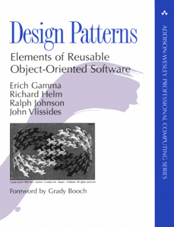

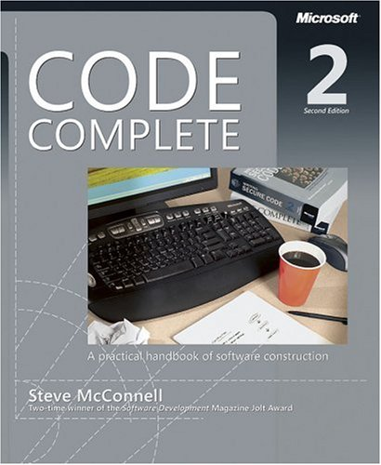
Dependencies
Notes:
We know a lot about how to write good code, and these books (among others) have good information about how to do it. Let’s focus in on the dependency aspect with a real-world example

Slide 7

Dependencies
Notes:
I have two kids

Slide 8
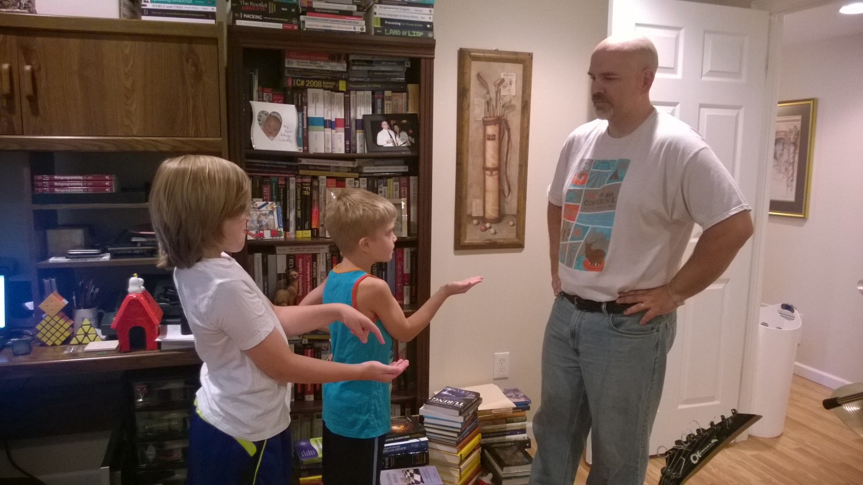
Dependencies
Notes:
They’re dependent on me. Sometimes they make requests from me, like “give me money!”

Slide 9
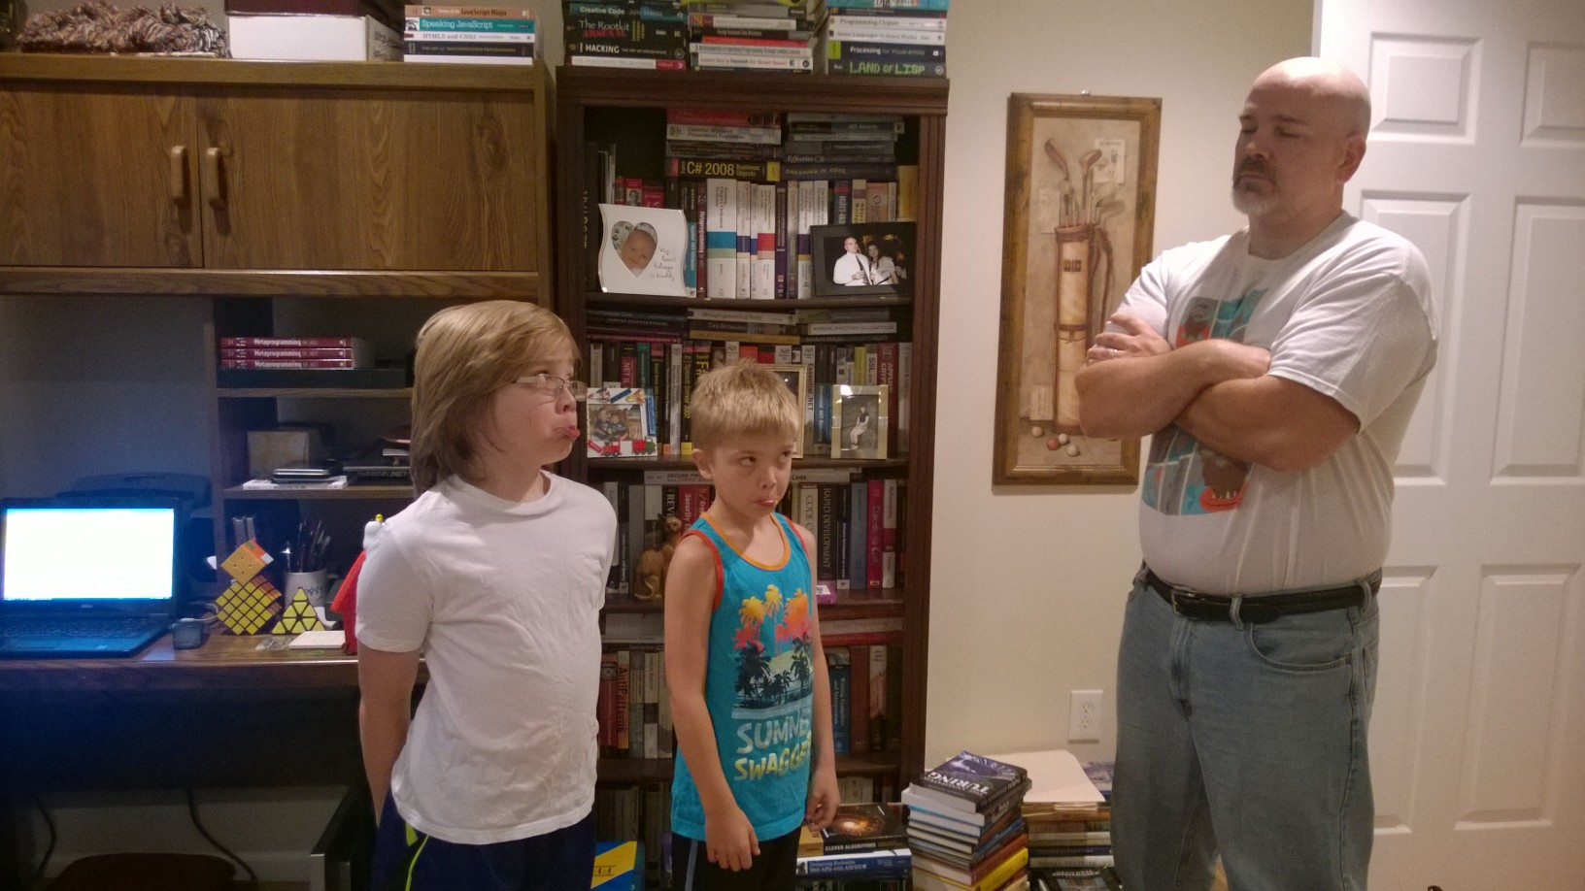
Dependencies
Notes:
I may return 0, or RoomNotCleanedException. (or even -2)

Slide 10
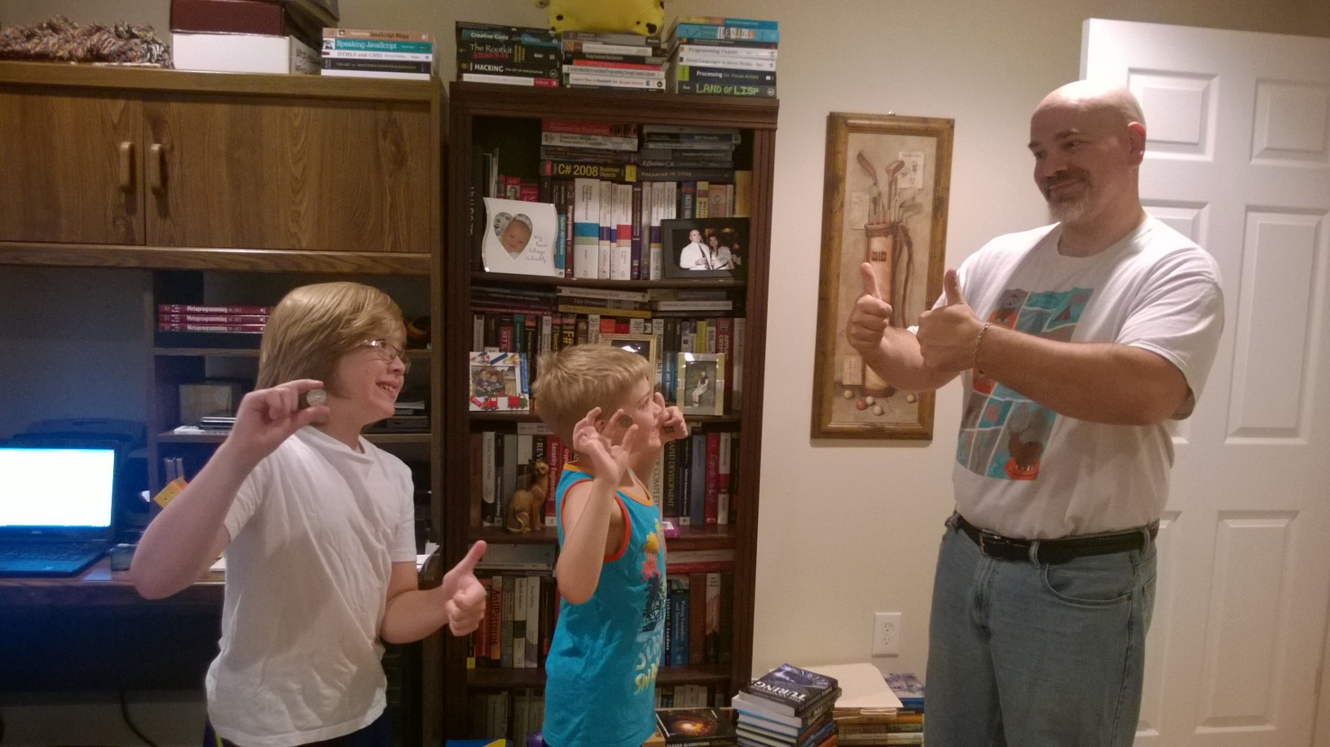
Dependencies
Notes:
Or I may pay them for their hard work (a quarter is a quarter!)

Slide 11
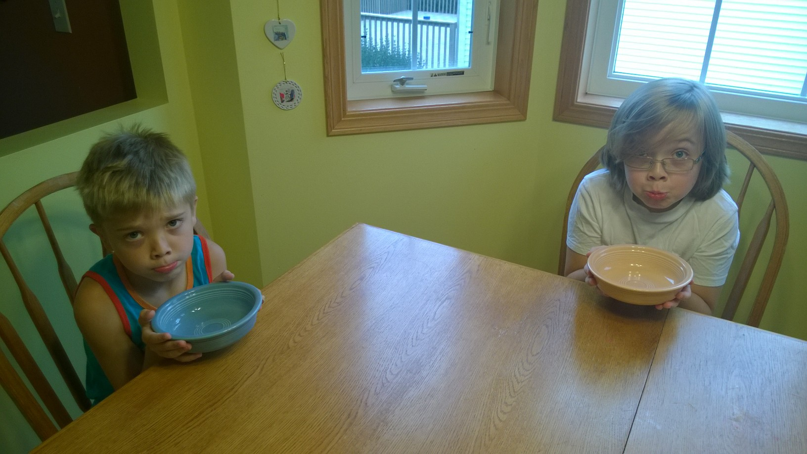
Dependencies
Notes:
If I don't work, make money, pay the mortgage, get groceries, etc. I turn into a null reference, and that's not good.

Slide 12
Dependencies
They're resources that you use in code that perform services that you need that you don’t “own”
Notes:
That’s all dependencies are. This is the simplest answer I could come up with off the top of my head

Slide 13
Dependencies
DB
Code
Notes:
A canonical example is DB access. You can write code that talks to a database directly, or…

Slide 14
Dependencies
DB Interface
Code
DB
Notes:
You can use an interface instead. The implementation is given to you, but you don’t know or care how it’s implemented. You just use the interface definition.
Note that this is usually passed into an object on construction. There are other ways to do it, but the majority of the time it’s constructor injection.

Slide 15
Dependencies
"Program to an interface, not an implementation"
Notes:
This is one of the best quotes in Design Patterns. The patterns themselves are good, but they’re all based on this premise. You don’t want to how the patterns are implemented; you just want to use them in a pluggable way.

Slide 16
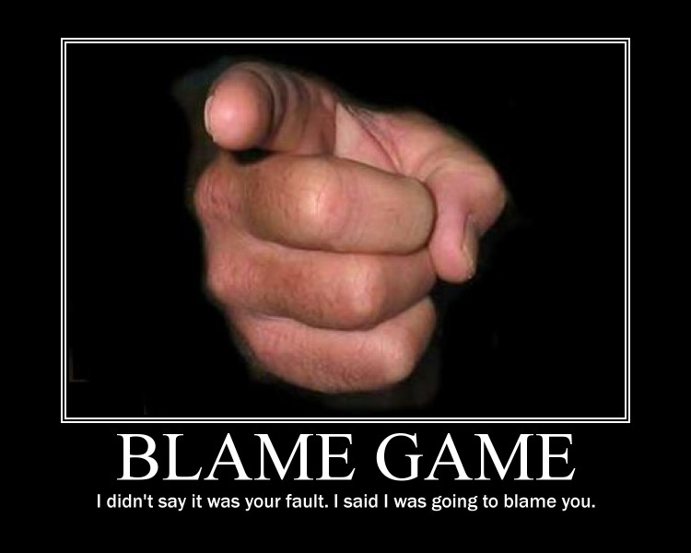
Dependencies
http://listcrux.com/wp-content/uploads/2013/12/Blame-Game.jpg
Notes:
And why is this beneficial? One, you can blame others ☺. In a way, this is a good thing. You don’t want that responsibility! Put the details of how to create the dependency somewhere else…in a central location…we’ll get back to that later.

Slide 17

Dependencies
http://westsmog.com/wp-content/uploads/2011/11/PassFail-Small.jpg
Notes:
It can make testing easier. You don’t have to have N number of dependencies up and running just to see if the code under test works. Integration/end-to-end testing is definitely needed, but having a suite of fast unit tests is a beautiful thing to have.

Slide 18
Dependencies
DB Interface
Code
Oracle
SQL Server
MySQL
Notes:
It also has the benefit that you can use different implementations, though I've personally not found that to be a huge win (YMMV)

Slide 19
Dependencies
Files
Services
Databases
Time
Randomness
Notes:
What are some examples of typical dependencies?
Files: Code that uses files doesn’t need to actually create the file. Interfaces are sufficient for this (like streams, or libraries like System.IO.Abstractions - https://github.com/tathamoddie/System.IO.Abstractions)
Services: Talking to a back-end REST or WCF service isn’t the goal: getting or updating information via these services iss
Databases: see above ☺
Time: Time can be hard to manage, especially in testing scenarios, where “DateTime.UtcNow” just doesn’t give enough fine grain control. Having a dependency provide time is a good thing (Reactive Extensions provides this via IScheduler)
Randomness: Ever try to test code that uses random data? Or what if you want to switch the random generator out?
This isn’t a complete list. You may choose to define other dependencies

Slide 20
Dependencies
Core Types
Algorithms
Notes:
What are some examples of atypical dependencies?
Core Types - things like int, string, etc.
Algorithms – if the algorithm is well-known and widely used
This doesn’t mean you can’t make dependencies out of these if you so choose.

Slide 21
Demo: Refactoring Code to Use Dependencies
Dependencies Demystified

Slide 22
Containers
Code
Code
Code
Dependency
Code
Code
Code
Notes:
What are some examples of atypical dependencies?
Core Types - things like int, string, etc.
Algorithms – if the algorithm is well-known and widely used
This doesn’t mean you can’t make dependencies out of these if you so choose.

Slide 23
Containers
Virtualize “new”!
…or not?
Notes:
What we need is a way to centralize how these dependencies are created and injected. It would be awesome (in a way) if the “new” operator could be virtualized so we could just make the dependencies at the site of usage. But….how does one “new up” an interface? And how does that make it explicit what dependencies are needed by an object?

Slide 24
Containers
Code
Code
Code
IoC.Container
Code
Code
Code
Notes:
Another thing devs will do is use a “service locator” pattern. There’s a global container defined that code knows about and resolves dependencies there.
DON’T.

Slide 25
Containers
Hides dependencies
Forced DI knowledge
Unit testing difficulties
Notes:
The first problem is that the SL approach isn’t explicit. You don’t know what the class needs to function properly. The DI version is explicit.
You also need to know that the class must have the SL configured.
Finally, if you run tests in parallel, you could end up with race conditions where one tests configures the SL but another overwrites it

Slide 26
Containers
Code
Code
Code
Composition Root
Code
Code
Code
Notes:
So let’s use a container that will manage all the defined dependencies in an application. That’s the responsibility of an IoC container

Slide 27
Containers
Register
Resolve
Release
Notes:
Containers should have the following three features:
Register – set up all dependencies
Resolve – get a dependency out of the container
Release – manage disposable resources

Slide 28
Demo: DIY IOC Implementation
Dependencies Demystified
Notes:
A small, useful-but-useless container.

Slide 29

Containers
http://netstorage.discovery.com/feeds/brightcove/asset-stills/dsc/136734381737214045601501197_SQUARE_WHEELS.jpg
Notes:
Now, we can reinvent the wheel, and just make one on our own. That’s what I’m going to do in the next demo, but keep in mind….you really shouldn’t do this. In fact this picture should be a warning that you shouldn’t spend the time doing it yourself, because mature containers do a lot more than just registering and resolving dependencies.

Slide 30
Containers
Relationship Types
Transient
Singleton
Lazy
And others
Object Lifetimes
Notes:
A DIY container will only get you so far. There are a lot of things that you need to consider when you create an container – even this list doesn’t cover them all.
Dependent objects should not care if the dependency is a singleton, is disposable, etc.

Slide 31
Containers
Singleton Parent
Dependency Registration
public sealed class DependentChild
{
private readonly IParent parent;
public DependentChild(IParent parent)
{
if(parent == null)
{
throw new ArgumentNullException(nameof(parent));
}
this.parent = parent;
}
Random Parent
Notes:
Dependents should be as ignorant as possible about the dependency they’re given. They shouldn’t care if the parent would always be the same one for the lifetime of the app, or if

Slide 32
Containers
Dependency Usage
public sealed class DependentChild
{
private readonly Lazy<IParent> parent;
public DependentChild(Lazy<IParent> parent)
{
if(parent == null)
{
throw new ArgumentNullException(nameof(parent));
}
this.parent = parent;
}
Registered Parent
Notes:
Dependents should also be able to control the usage of a dependency – e.g. if the dependency isn’t always used, it should be able to specify that it’s a Lazy<>, even if the dependency wasn’t registered that way.

Slide 33
Containers
Dependency Dependencies
public sealed class DependentChild
{
private readonly IParent parent;
public DependentChild(IParent parent)
{
if(parent == null)
{
throw new ArgumentNullException(nameof(parent));
}
this.parent = parent;
}
IDisposableParent :
IParent, IDisposable
Notes:
Dependents should not care if the dependency is disposable. In fact, it can’t, as this example shows. But SOMEBODY has to care that it’s disposable.

Slide 34
Containers
StructureMap
Unity
Autofac
Ninject
LinFu
Funq
And, like, a thousand others ☺
Notes:
And there’s a LOT of containers out there than you can pick for .NET. There really is no reason to do it yourself, unless you’re either:
Really interested to see if you can make one work
You’re convinced you can do it better!

Slide 35

Containers
http://i5.asn.im/couple-arguing-_ucgr.jpg
Notes:
Of course, which one you pick is really up to you. There’s no good reason to spend a significant amount of time – the most popular ones essentially do the same thing in their own ways. Fighting over a specific container isn’t worth the time.

Slide 36
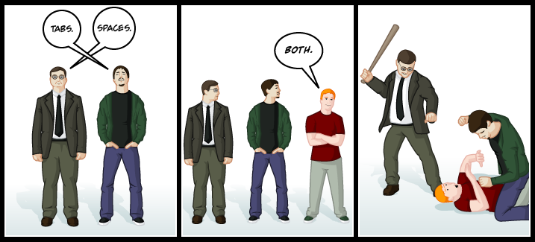
Containers
http://www.emacswiki.org/pics/static/TabsSpacesBoth.png
Notes:
It’s like fighting over tabs or spaces. We all know tabs is correct, why waste that time? ☺

Slide 37

Containers
http://autofac.org/
Notes:
My personal preference is Autofac. It’s very flexible and provides a lot of dependency management features that I find appealing. But again, if you use StructureMap, or Ninject, those will work just fine.

Slide 38
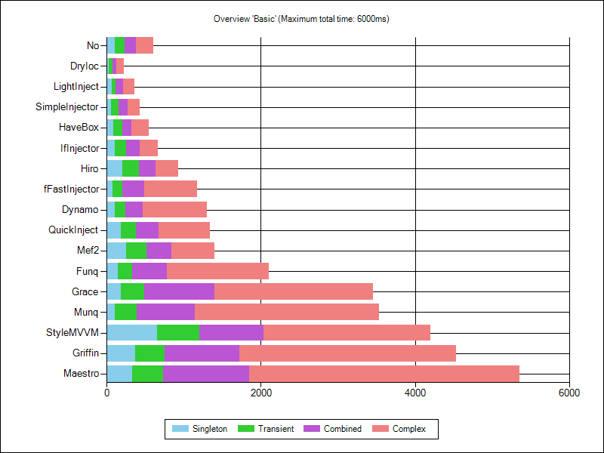
Containers
http://www.palmmedia.de/Blog/2011/8/30/ioc-container-benchmark-performance-comparison
Notes:
There are great sites that have done a lot of performance investigations into each framework, so check them out and use that to guide your choice.

Slide 39
Containers
AssemblyC
AssemblyCModule
AssemblyA
AssemblyAModule
App
AssemblyD
AppModule
AssemblyDModule
AssemblyB
AssemblyBModule
Notes:
Register dependent modules first, then register yours (last one wins)
App/host builds container and sets configuration section reader (if needed)

Slide 40
Demo: Using Autofac
Dependencies Demystified
Notes:
So let’s see how we can use Autofac to register dependencies and resolve them using a Lazy<> and a Func<string, T>, where the former isn’t registered, but the latter is:

Slide 41
Containers
Console
XAML
.NET Core
WinService
Frameworks
Notes:
Now, most of us aren’t writing console applications for production; other application hosts are used. And now .NET Core introduced a “common” DI framework.

Slide 42
Containers
Console
XAML
.NET Core
WinService
Frameworks
Container
Notes:
Most modern hosts have integration points with NuGet packages that make it pretty simple to put your favorite IoC in play with the application.

Slide 43
Demo: Autofac and .NET Core Integration
Dependencies Demystified
Notes:
Last demo: use Autofac with .NET Core

Slide 44
Conclusion
“The reason that I use IoC is not to encourage testing, it is not to break dependencies, it is not to get separation of concerns…I am using IoC because it makes all of the above so easy.”
http://ayende.com/blog/2887/dependency-injection-doesnt-cut-it-anymore
Notes:
This sums it up well

Slide 45
Dependencies Demystified
Jason Bock
Remember…
https://github.com/JasonBock/DependenciesDemystified
https://github.com/JasonBock/Presentations
References in the notes on this slide
Notes:
* Dependency injection in ASP.NET Core - https://docs.microsoft.com/en-us/aspnet/core/fundamentals/dependency-injection
* Essential .NET - Dependency Injection with .NET Core - https://msdn.microsoft.com/en-us/magazine/mt707534.aspx
* .Net Core Dependency Injection - https://stackify.com/net-core-dependency-injection/
* Inversion of Control Patterns for the Microsoft .NET Framework - https://visualstudiomagazine.com/articles/2010/08/01/inversion-of-control-patterns-for-the-microsoft-net-framework.aspx
* List of .NET Dependency Injection Containers (IOC) - http://www.hanselman.com/blog/ListOfNETDependencyInjectionContainersIOC.aspx
* IoC Container Benchmark - Performance comparison - http://www.palmmedia.de/Blog/2011/8/30/ioc-container-benchmark-performance-comparison
* IoC Battle: http://www.iocbattle.com/
* Inversion of control containers – Best practices - http://www.dotnetcodegeeks.com/2012/05/inversion-of-control-containers-best.html
* Building an IoC container in 15 lines of code - http://ayende.com/blog/2886/building-an-ioc-container-in-15-lines-of-code
* Using IDisposable with Autofac - http://binarysculpting.com/2012/08/19/using-idisposable-with-autofac/
* Service Locator is an Anti-Pattern - http://blog.ploeh.dk/2010/02/03/ServiceLocatorisanAnti-Pattern/
* Dependency Injection in ASP.NET Core - https://blogs.msdn.microsoft.com/webdev/2016/03/28/dependency-injection-in-asp-net-core/
* Dependency Injection with .NET Core - https://msdn.microsoft.com/en-us/magazine/mt707534.aspx

